Slide 1
Transistor Titans
Data Analysis
Zala Marušič, Volkan Sönmezler
Notes:
.

Slide 2
Dataset description
Notes:
.

Slide 3
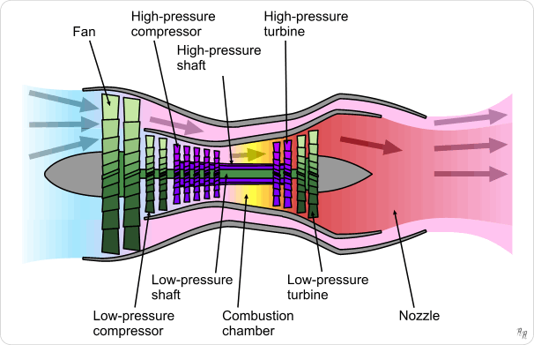
NASA Turbofan Jet Engine Data Set
Engine degradation simulation was carried out using C-MAPSS.
Records several sensor channels to characterize fault evolution.
The data set was provided by the Prognostics CoE at NASA Ames.

Slide 4
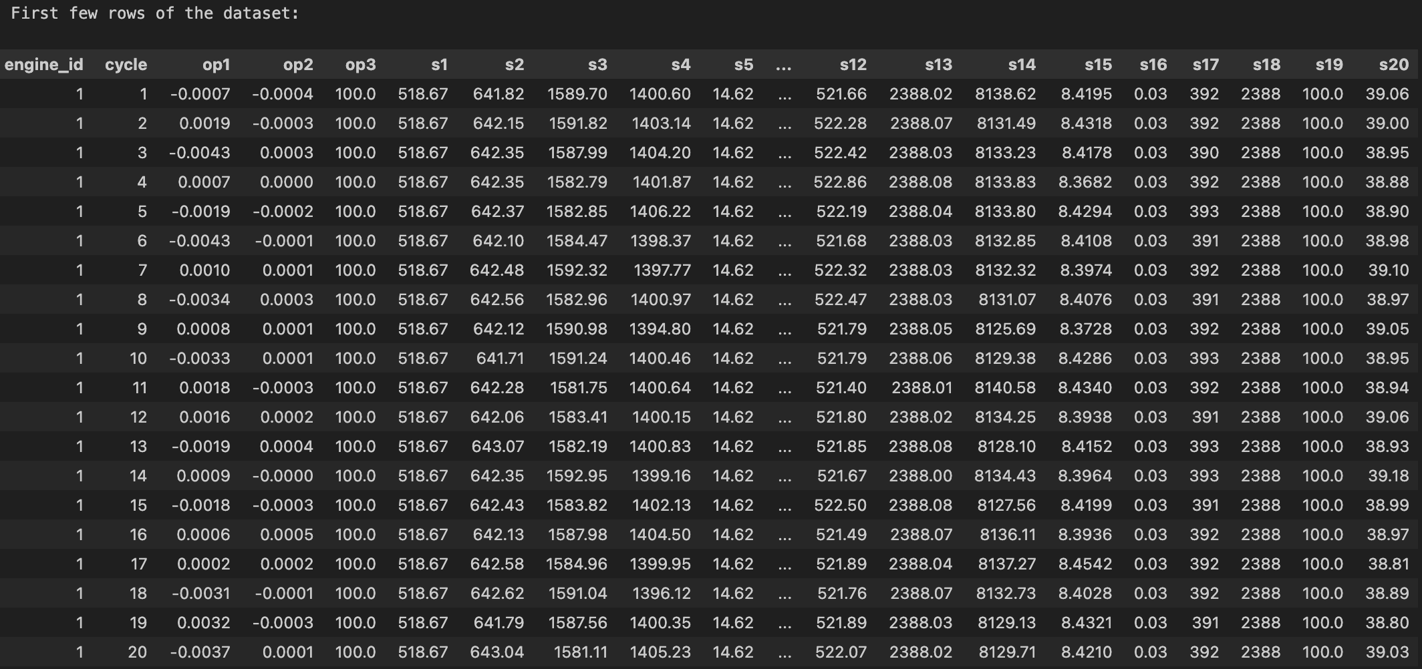
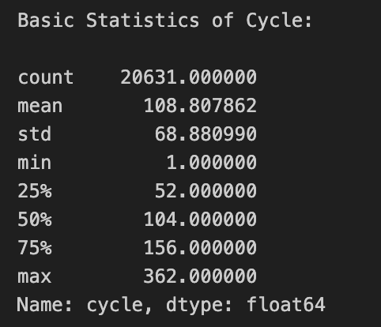
Dataset Characteristics
Notes:
Op = operational setting

Slide 5
Data PREPROCESSING
Notes:
.

Slide 6
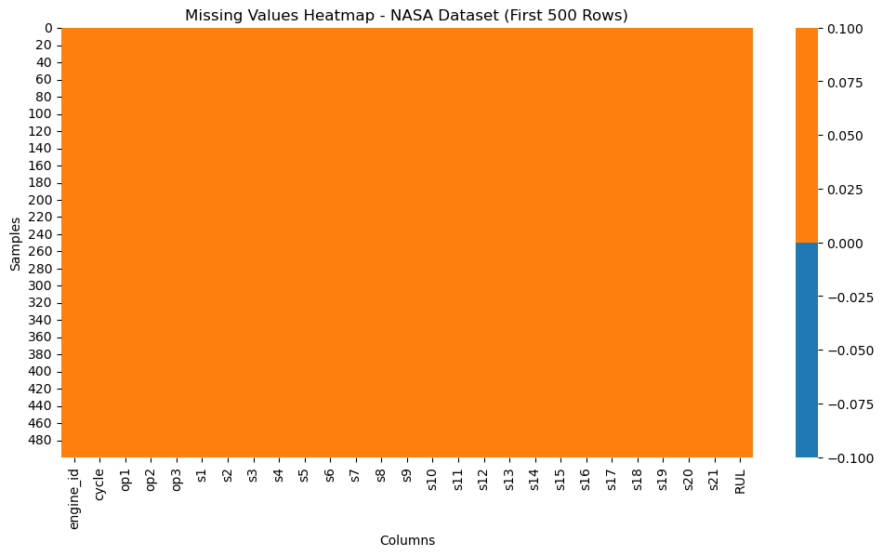
Missing Values

Slide 7
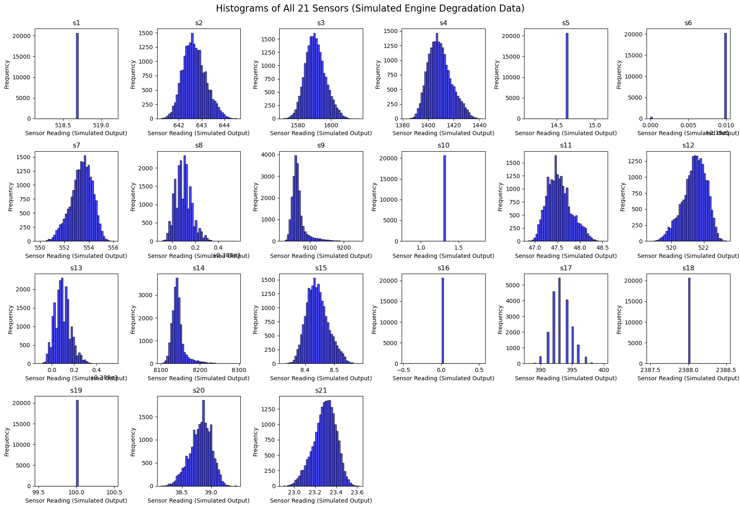
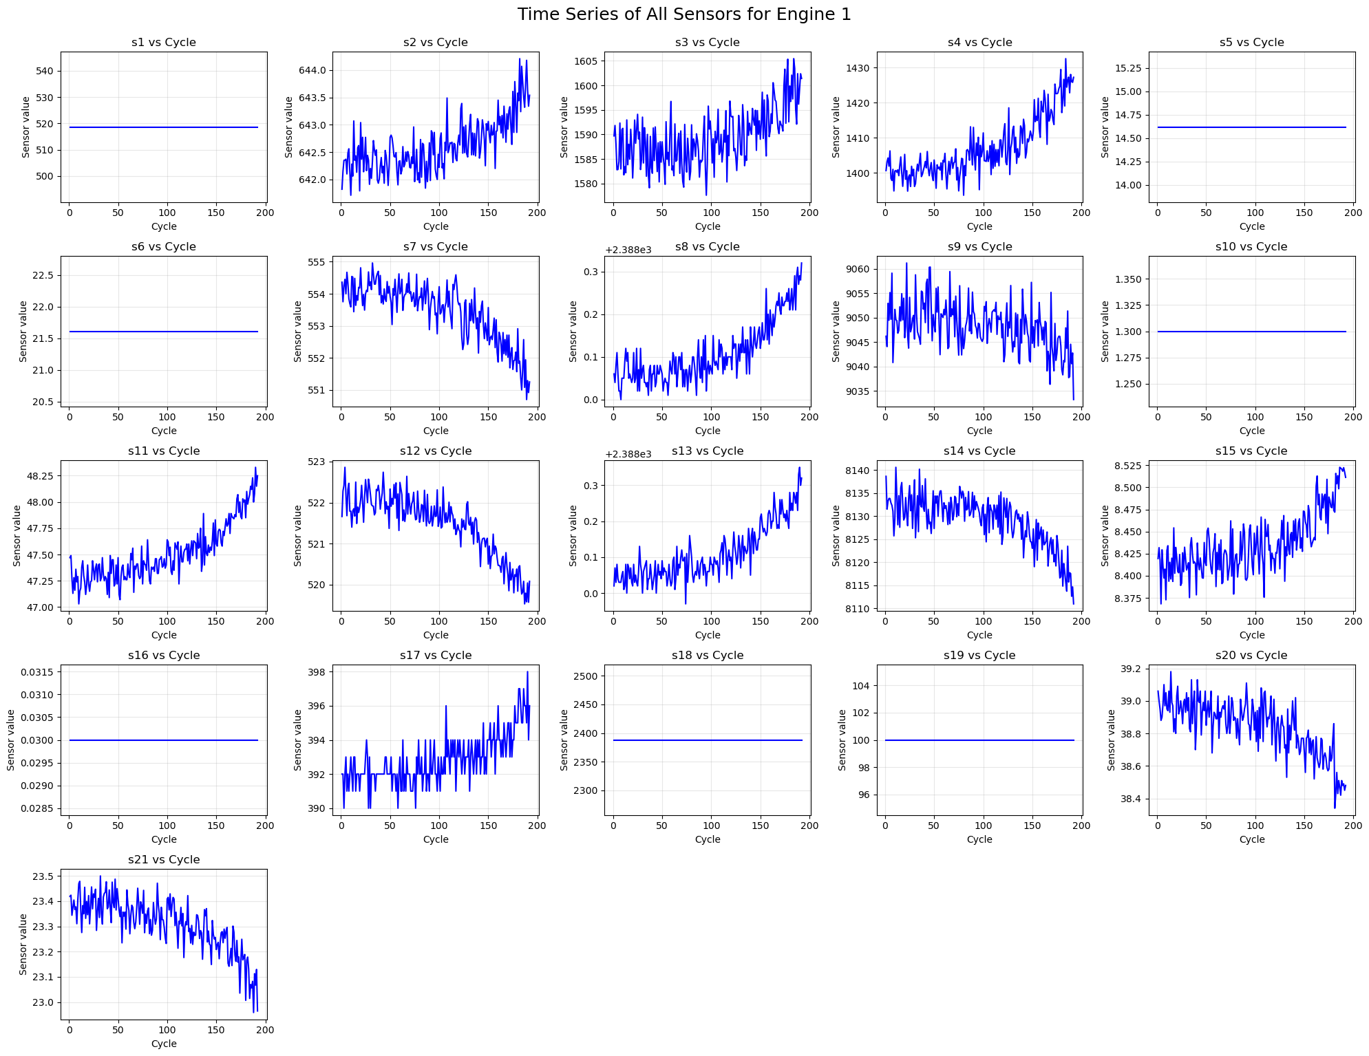
Visualization

Slide 8
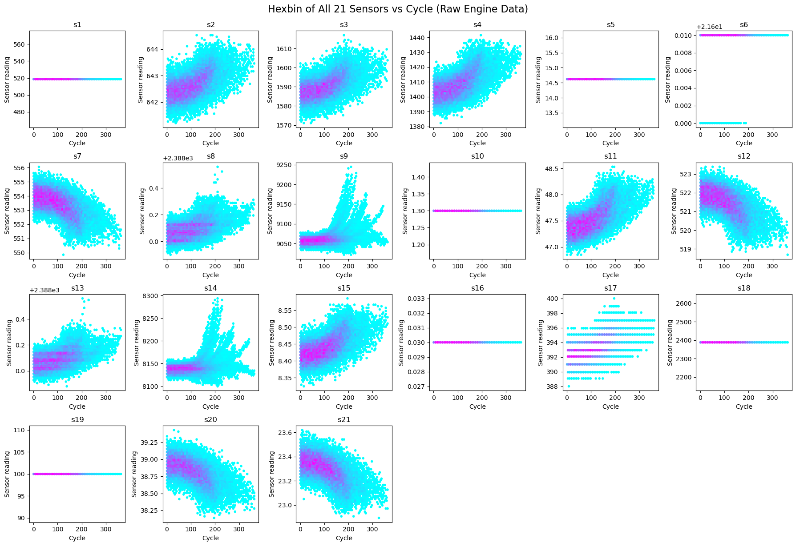
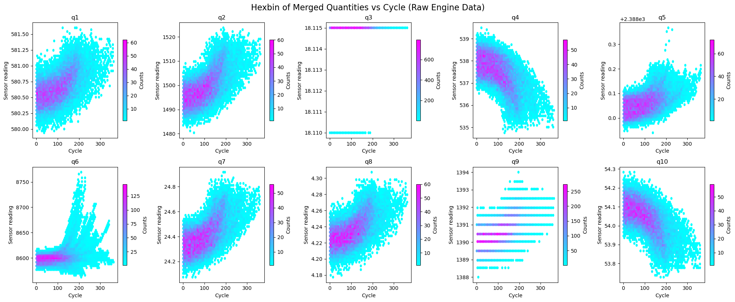
Quantity Derivation

Slide 9
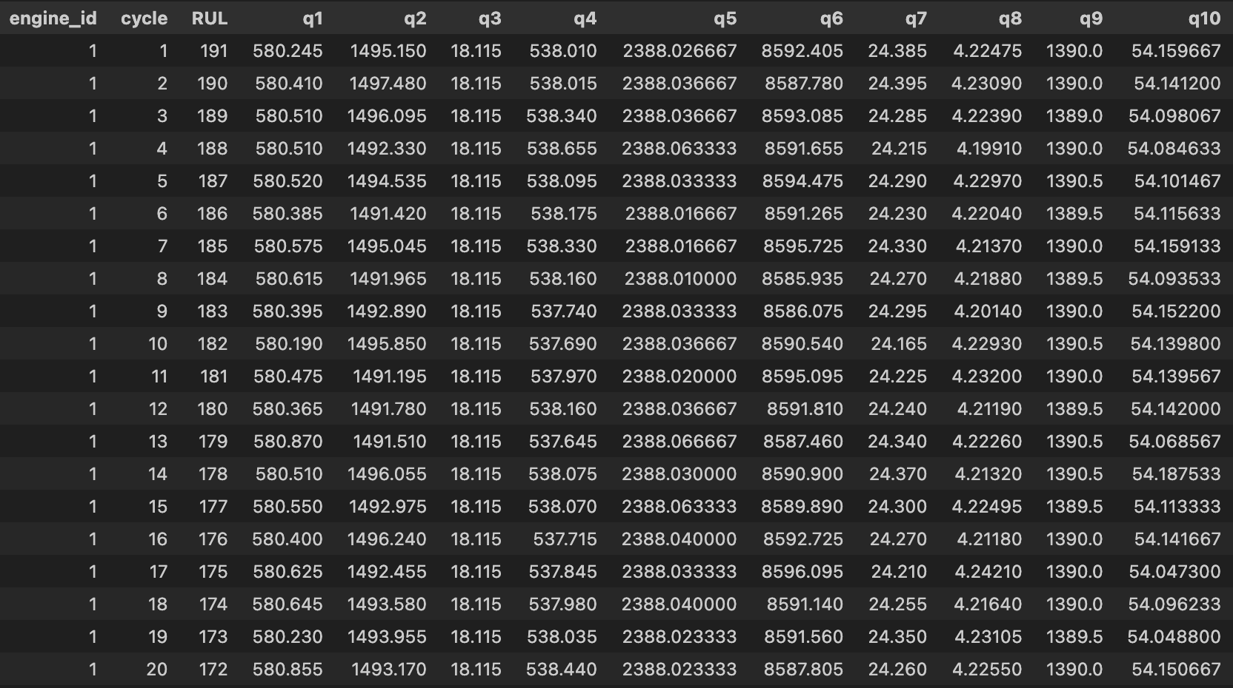
Cleaned Dataset

Slide 10
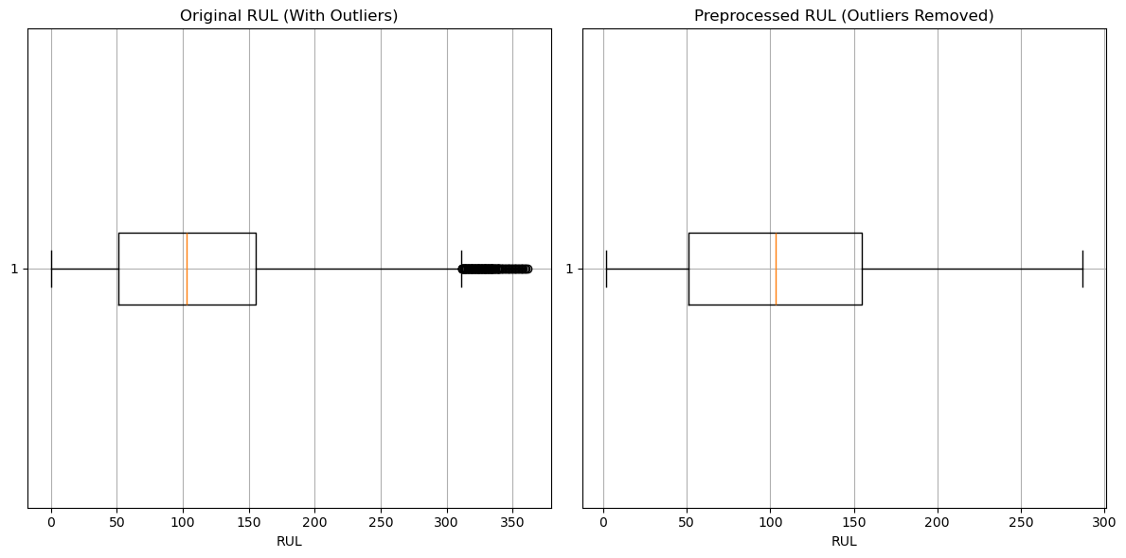
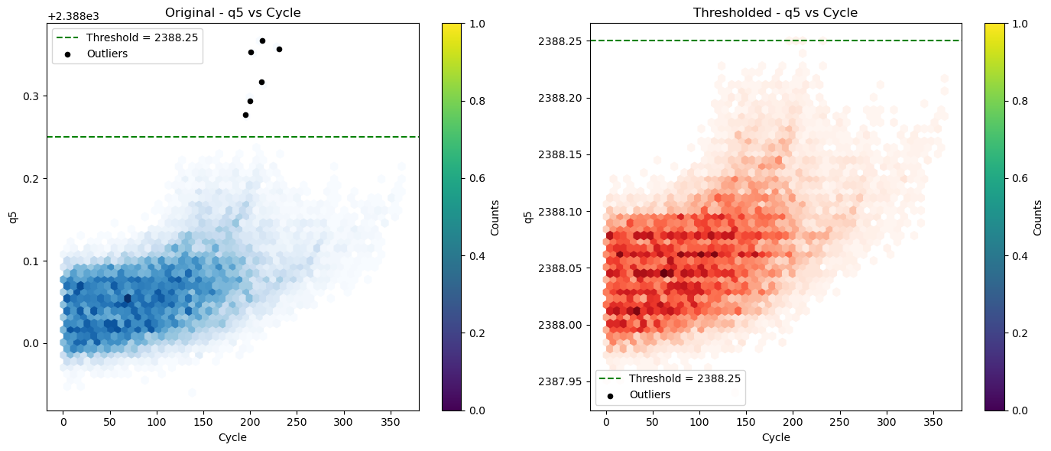
Original vs Cleaned

Slide 11
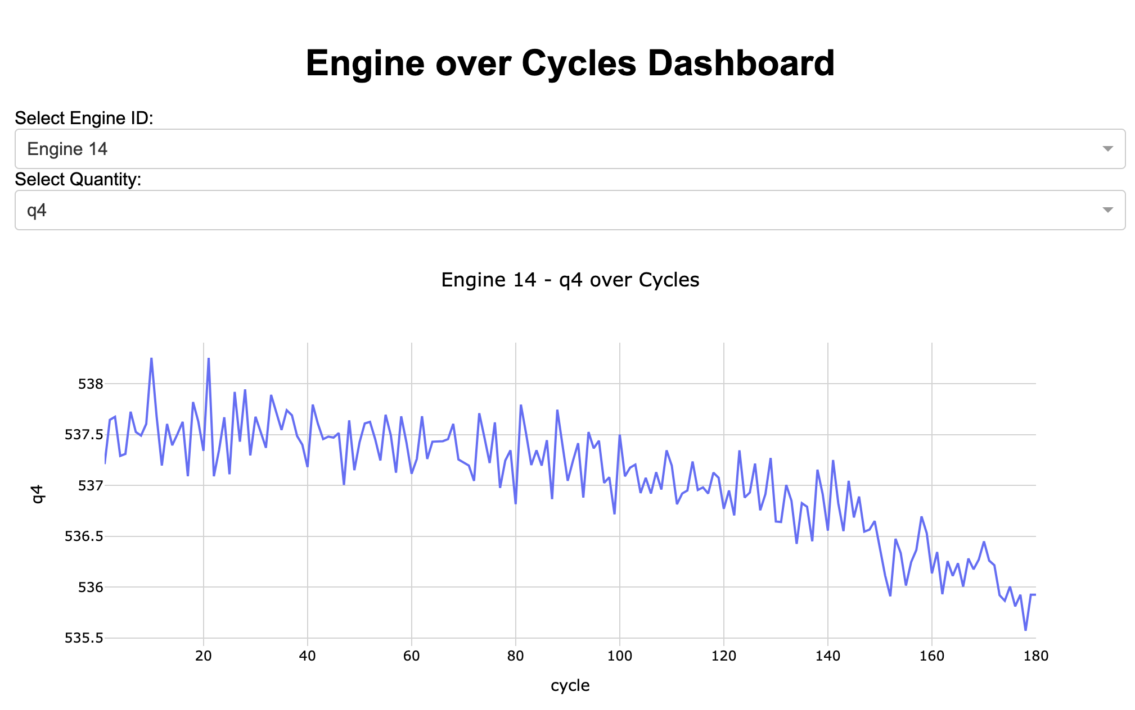
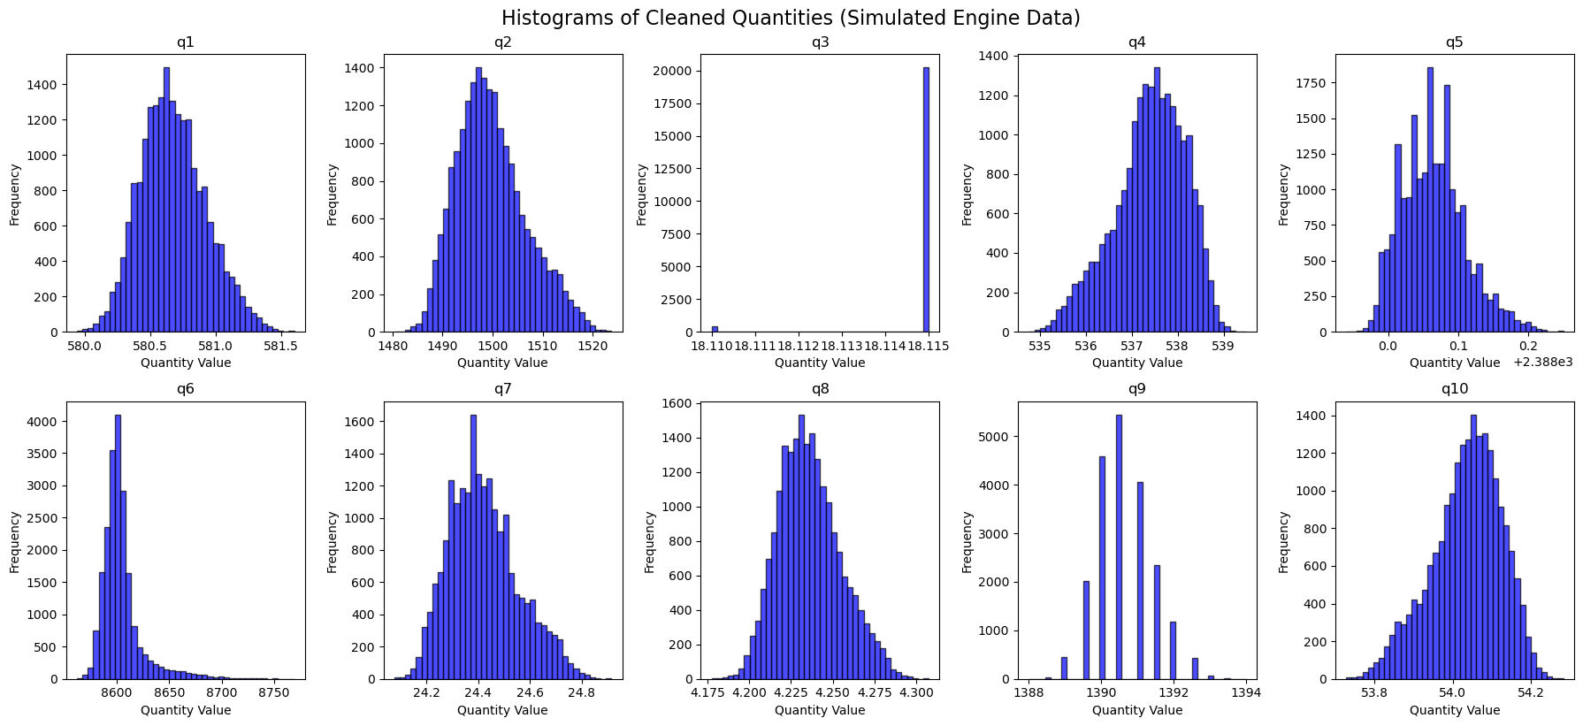
Visualization of Cleaned Data
https://www.geeksforgeeks.org/data-visualization/creating-interactive-dashboard-from-jupyter-notebooks/

Slide 12
Observed pATTERNS

Slide 13
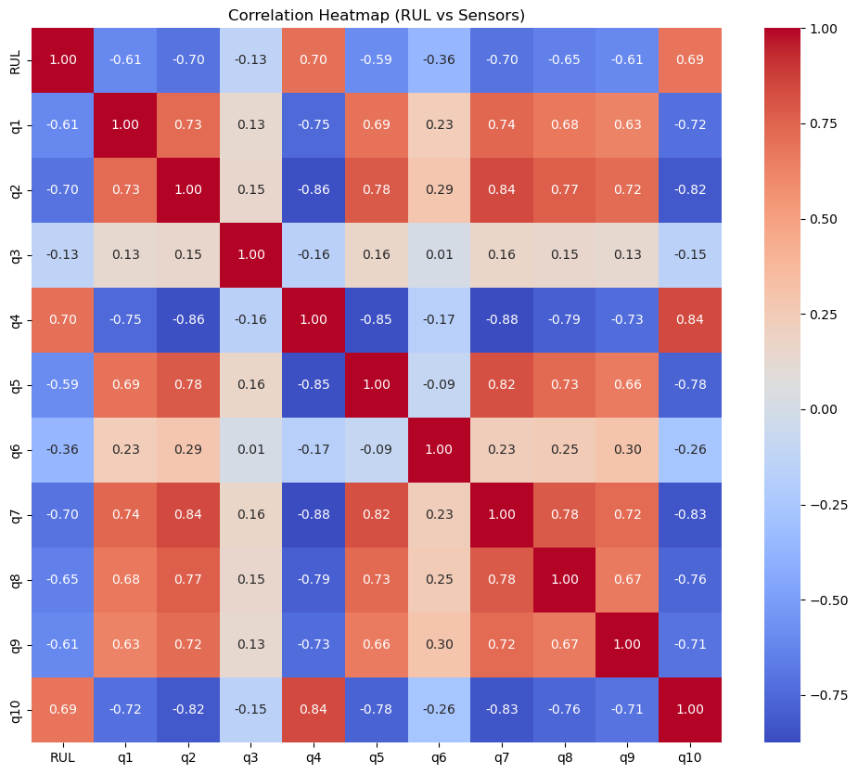
Correlation
q4 (+0.84) — strongest predictor, positive correlation
q10 (+0.69) — good predictor, positive correlation
q2 (-0.70) — strong negative indicator of RUL
q1, q7, q8, q9 (-0.61 to -0.65) — moderate inverse predictors
Notes:
Q4 + q10 regression analysis

Slide 14
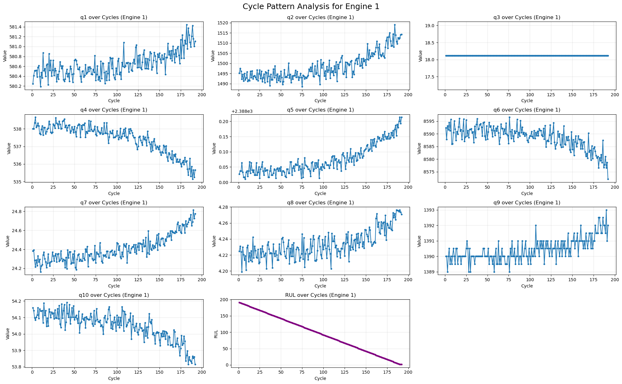
Cycle Patterns
No clear cyclical or periodic (daily) patterns are present in the engine data. Variations are dominated by long-term degradation trends rather than short-term oscillations, which is consistent with controlled operational conditions and gradual wear processes in turbofan engines.

Slide 15
probability

Slide 16
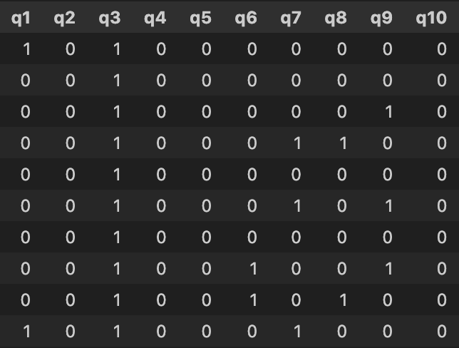
Low-Health Estimation
Identifying observations that fall below the 10th percentile threshold for each quantity.
Values at or below this lower percentile are classified as low health.

Slide 17
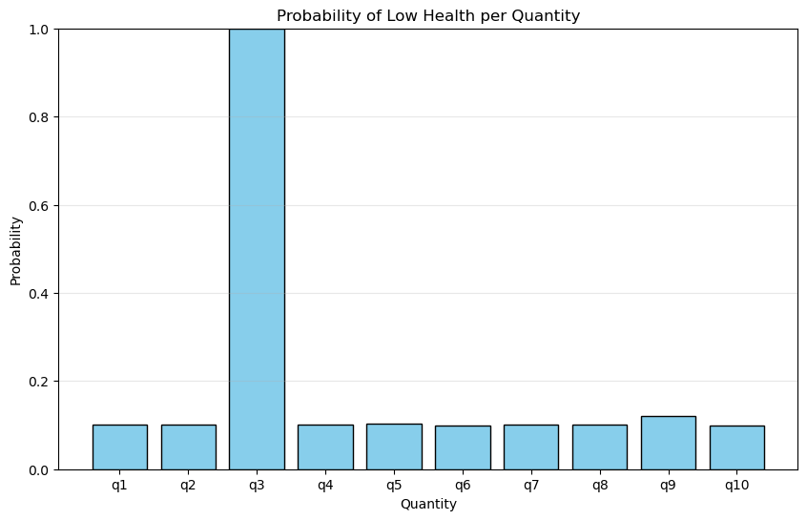
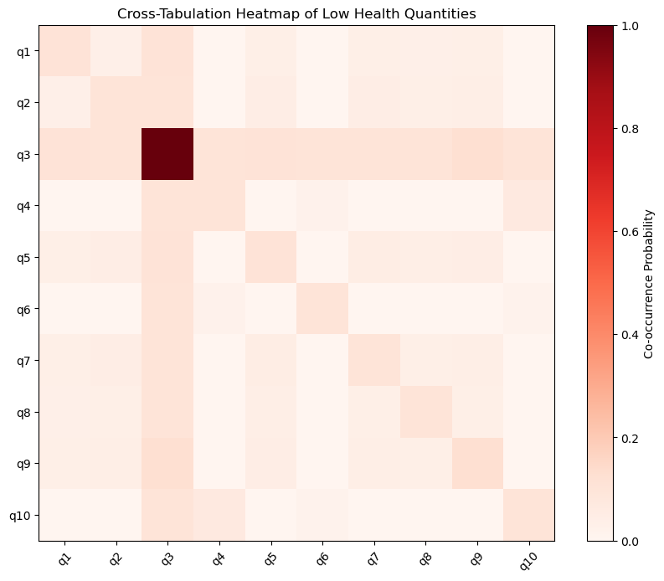
Low Health per Quantity

Slide 18
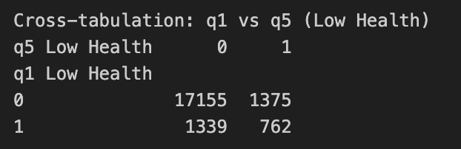
Cross Tabulation
How often do low-health states occur simultaneously?
- In 17,155 cases, neither q1 nor q5 is in a low-health state.
- q5 shows low health while q1 remains normal in 1,375 observations.
- q1 shows low health while q5 remains normal in 1,339 observations.
These similar counts suggest that both quantities independently enter low-health states at comparable rates.
- Both q1 and q5 are in a low-health state in 762 observations.
This represents a substantial co-occurrence relative to the total number of low-health cases.

Slide 19
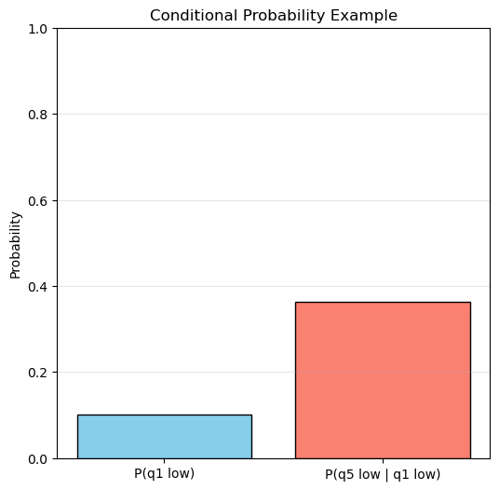
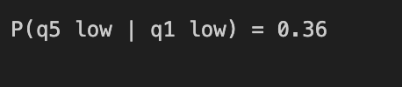
Conditional Probability
What is the likelihood of one measured quantity exhibiting a low-health state given that another quantity is already in a low-health state?
When q1 is in low health, there’s a 36% chance
that q5 is also low.
This indicates moderate correlation between
degradation in these two quantities.

Slide 20
Statistical theory

Slide 21
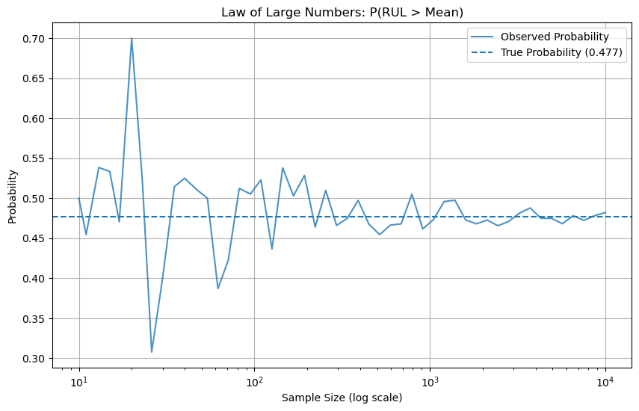
Law of Large Numbers
The Law of Large Numbers (LLN) states that as the sample size increases, the sample statistic (e.g., sample mean, probability) will converge to the true population parameter. We will demonstrate this using our sensor count data.

Slide 22
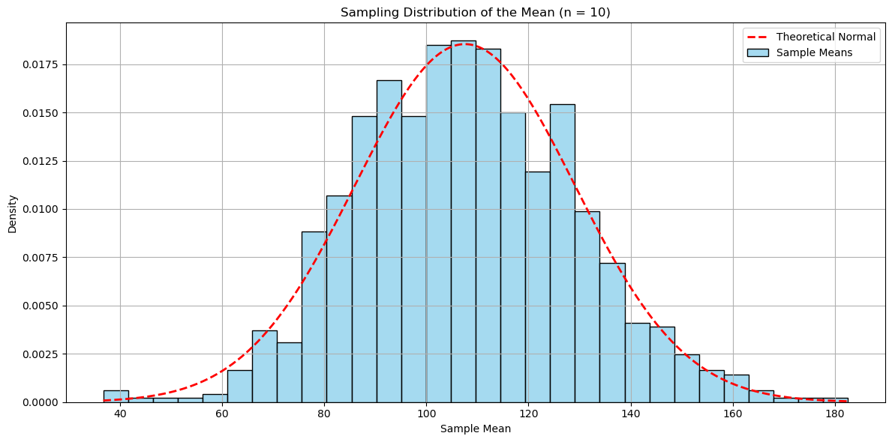
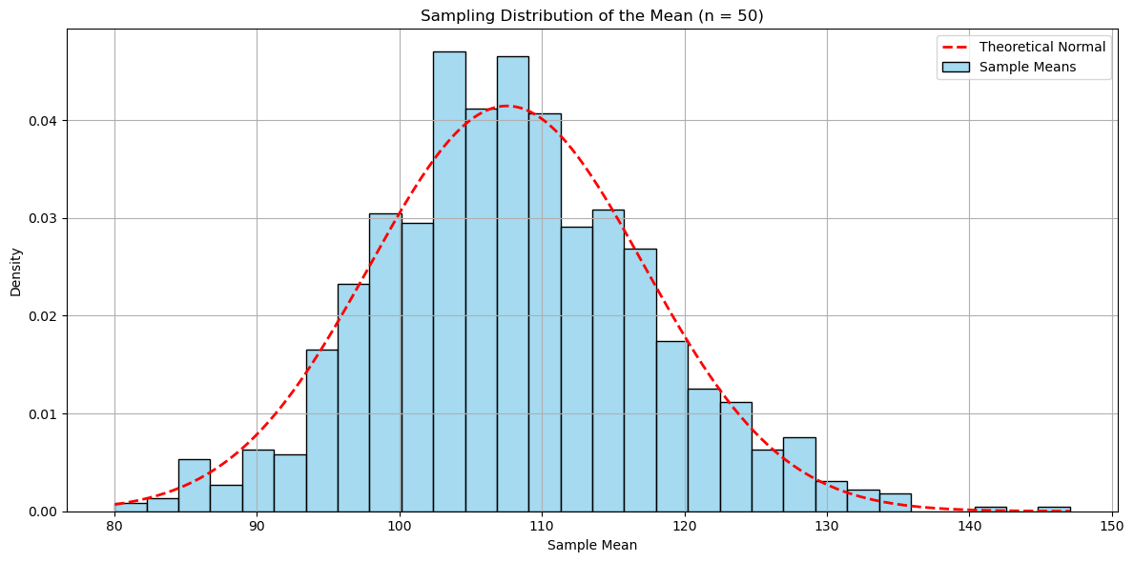
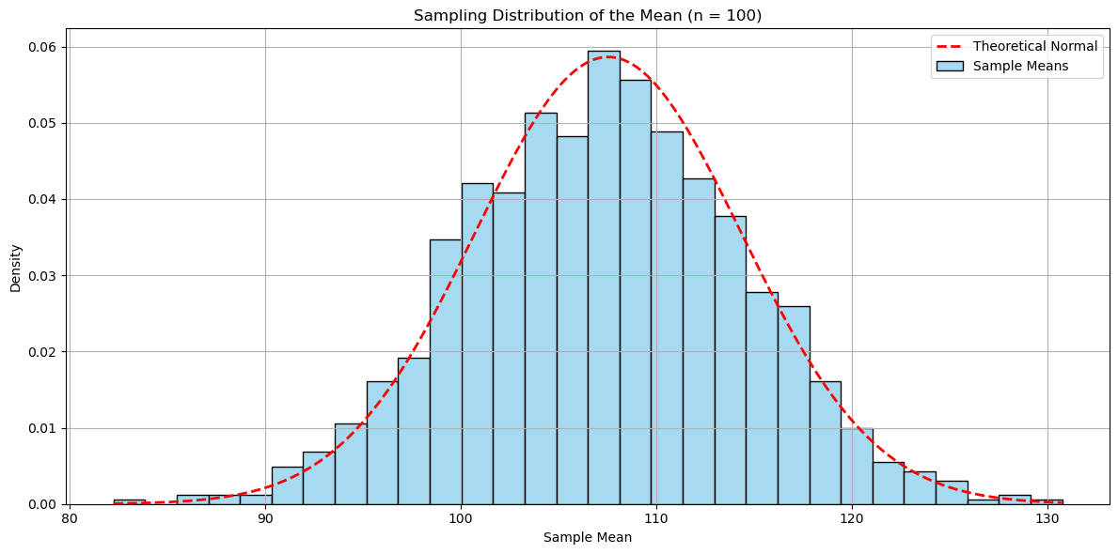
Central Limit Theorem
Multiple random samples were drawn from the dataset, each of a fixed size. The mean for each sample was computed.
It was observed that the distribution of sample means became normal as the sample size increased.

Slide 23
Regression analysis

Slide 24
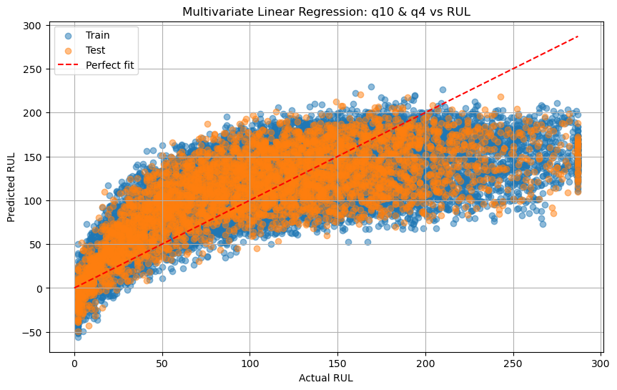
Linear Regression
An engine operates normally at the start and only develops a fault at some point.
During that normal phase, sensors like q4​ and q10​ don't change much. To the model, a "very healthy" engine and a "slightly worn" engine look identical, so it predicts an average value (the plateau).
The model is much more accurate when the Actual RUL is low (0–50 cycles) -> most reliable right before failure.

Slide 25
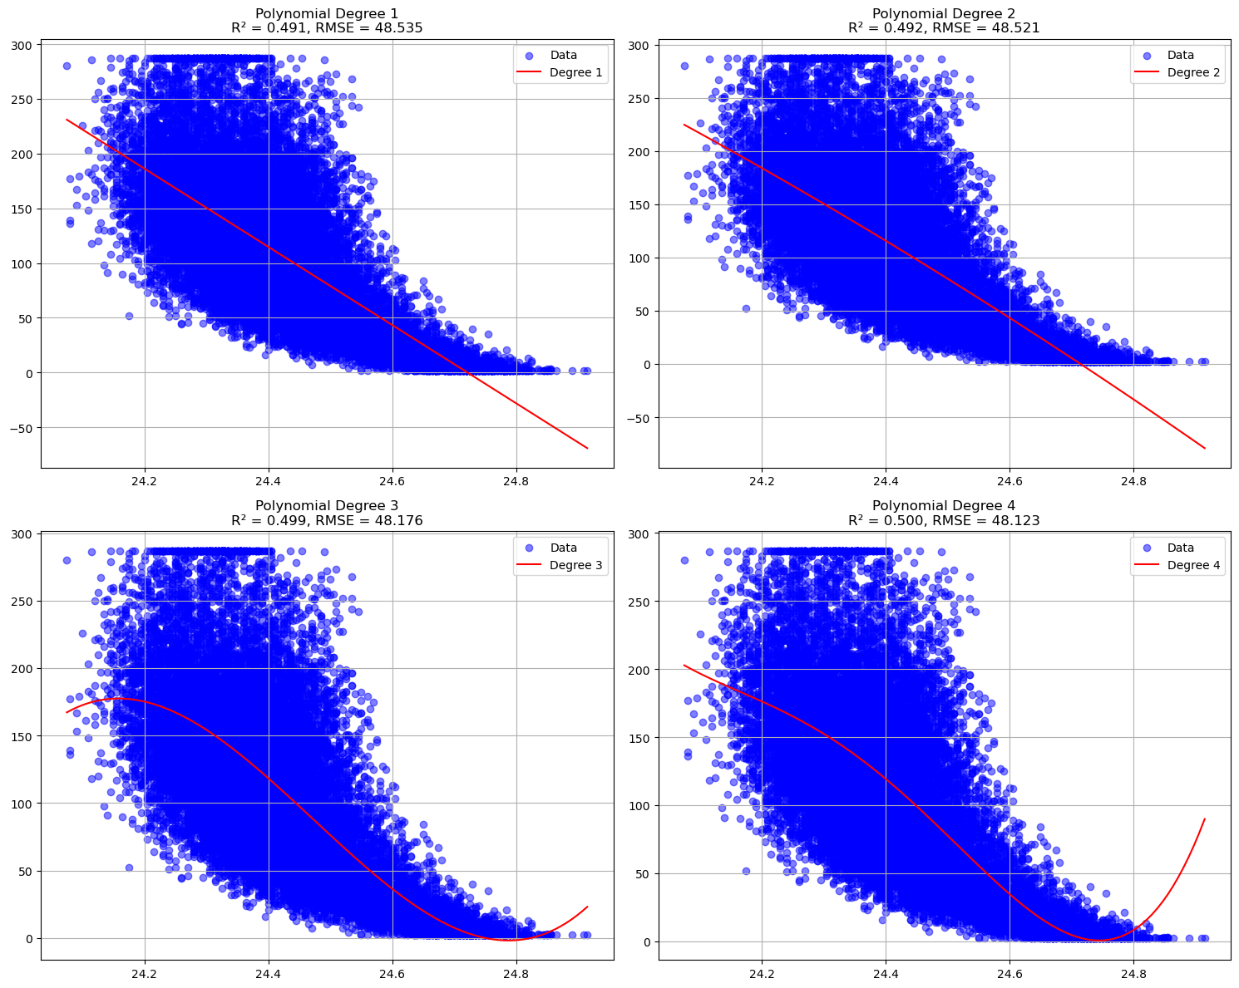
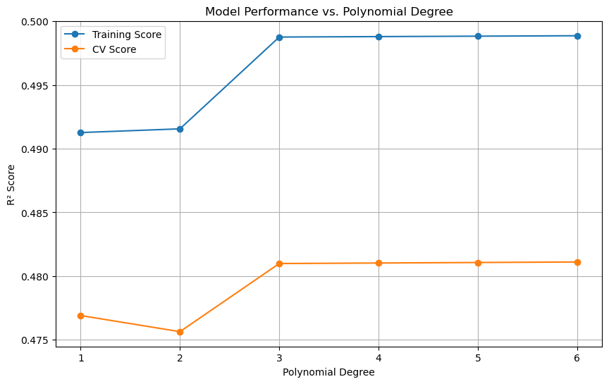
Polynomial Degree
Low sensor values correspond to high RUL (early in engines life)
High Sensor Values: Correspond to low RUL (approaching failure)
This confirms that q7 is a strong indicator of engine degradation.
Non-linear relationship between measurements and degradation
Degree 3 is optimal, since 4, 5 and 6 do not improve

Slide 26
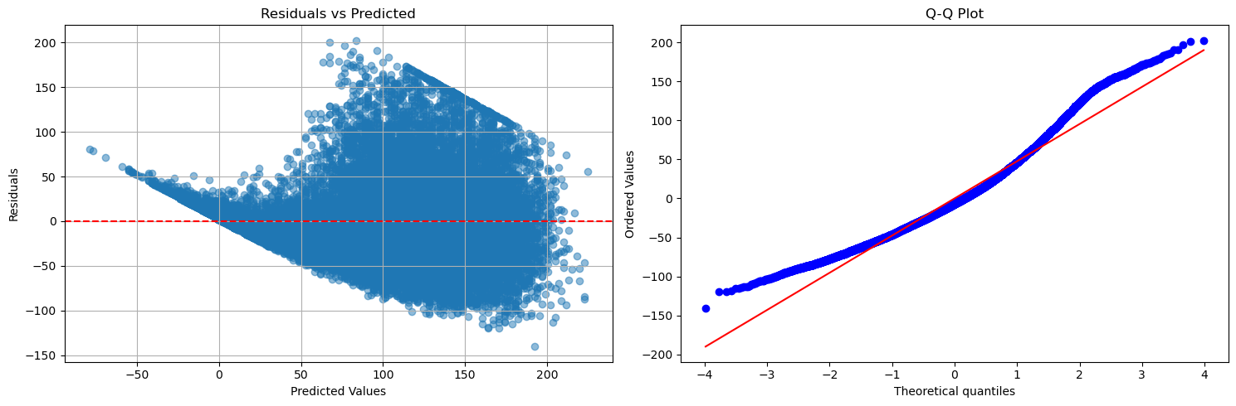
Residual Analysis
At certain predicted RUL values, the model consistently either overshoots or undershoots the actual value. This is likely because engine degradation is relatively flat early on (high RUL) and then accelerates rapidly toward the end.
Curves at tail ends
Model produces more "extreme" errors than a standard normal distribution would predict.
This deviation is likely caused by the "manufacturing variation" and "sensor noise" in the C-MAPSS data.

Slide 27
Dimensionality Reduction

Slide 28
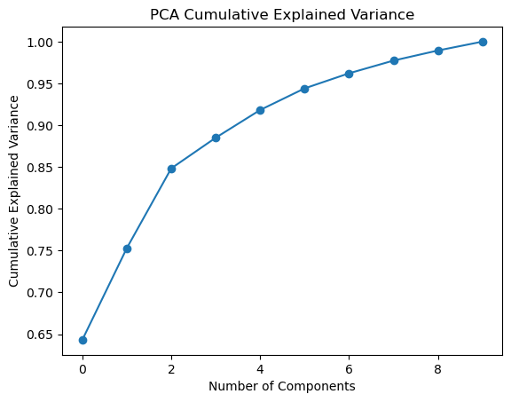
Variance
The first principal component explains approximately 64% of the total variance.
The first two components explain about 85%, and the first four components exceed 90% of the variance.
Additional components contribute progressively smaller amounts of information, indicating diminishing returns beyond the first few components.
This suggests that the original 10 quantities can be effectively reduced to 3–4 principal components with minimal information loss.

Slide 29
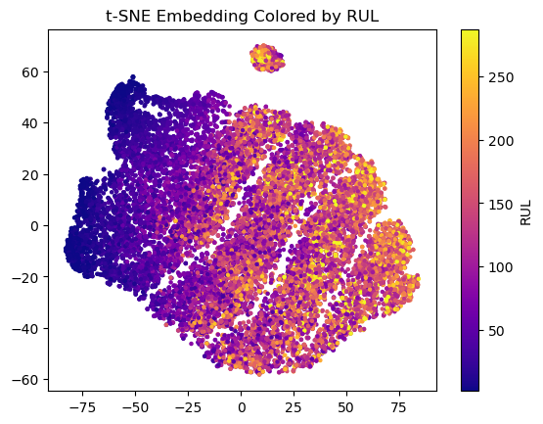
t-SNE
The 2D embedding shows a gradient from low to high RUL across the space.
Early-life engines (low RUL) cluster mostly on the left, while near-failure engines (high RUL) appear on the right.
Some overlapping regions indicate engines with intermediate degradation levels share similar sensor patterns.

Slide 30
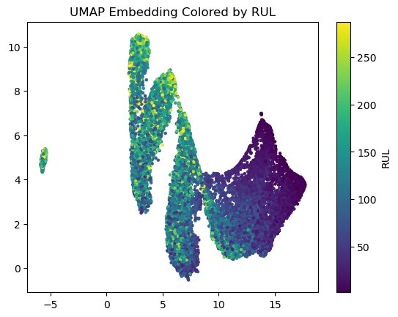
UMAP
UMAP shows clearer separation between RUL groups compared to t-SNE.
Clusters are more structured, with a vertical progression from high to low RUL.
Local clusters correspond to engines with similar degradation stages.

Slide 31
HYPOTHESES

Slide 32
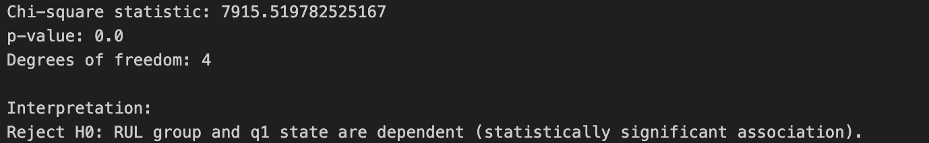
Hypothesis: RUL and q1 are independent
The chi-square test confirms a statistically significant association between RUL group and q1 state.
This aligns with earlier observations that q1 tends to change systematically as the system degrades.

Slide 33
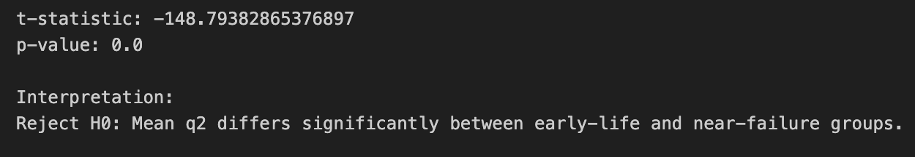
Hypothesis: Mean q2 is equal for both groups
Extremely large t-statistic (in magnitude) → the means of early-life vs near-failure groups differ strongly.
Interpretation: q2 decreases (or increases) systematically with degradation.

Slide 34
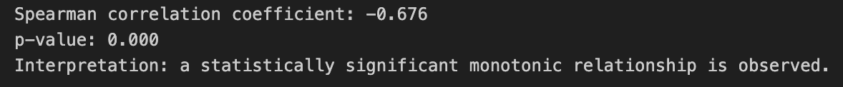
Hypothesis: q6 follows a monotonic trend
q6 yielded a correlation coefficient of 𝜌=−0.676 with a p-value <0.001.
This indicates a strong and statistically significant negative monotonic relationship between the two variables.
The result suggests that as the engine progresses through its operational cycles, q6 tends to decrease in a consistent monotonic manner, likely reflecting systematic degradation effects rather than random sensor variation.

Slide 35
NEXT STEPS

Slide 36
– Sensors could be analyzed individually to identify subtle early-warning patterns.
– PCA or clustering could be applied over time to detect emerging degradation modes across engines, informing maintenance scheduling.

Slide 37
DISCUSSION

